Slide 1

Scouting Network
xG Scout
Powered by xG
An xG based Scouting System for Football

Slide 2
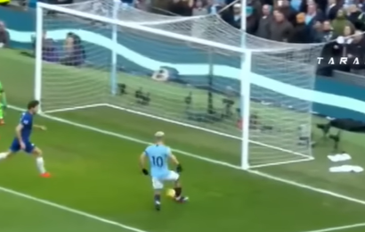
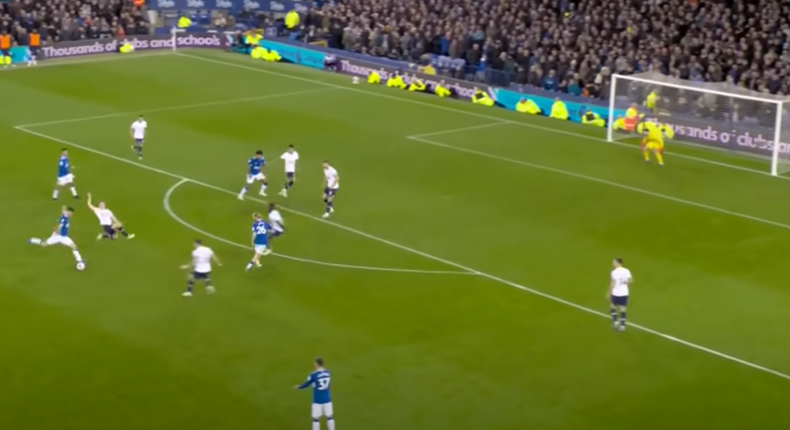
WHAT IS xG
xG is an emerging stat in football.
It basically tells you the probability of a player scoring from a particular shot taking into account the distance to the goal and the angle of the shot.
Close to Goal
xG=0.98
Far from goal
xG=0.02

Slide 3
How does this metric help us
xG therefore, can serve as a gauge of how potent a team is in attack and how solid they are at the back.
It can be used to analyse a players ability to create chances and more importantly, how many of these chances he converts.
Moreover, we can use this metric to search for players, who have a relatively higher xG compared to others and so on.
This can help in setting up an effective scouting system for teams, by comparing the players’ xG, and thus,
SAVE MILLIONS for a team

Slide 4
An xG based Scouting System?
Scouting has become an integral part for teams today;
From finding underrated players, to finding popular players to finding “tomorrow’s stars”.
An xG based scouting system, might be unheard of today, but will become a buzzword in the future
This model uses xG to “hunt” for or “scout” players around the world
Based on a number of metrics and mind-boggling stats, a player is recommended to the team.

Slide 5
LETS TAKE AN EXAMPLE
xG is NOT player dependant
Player Name | Goals Scored | xG | Differential
Victor Osimhen | 21 | 20.58 | -0.42
Lautaro Martinez | 14 | 14.78 | +0.78
Olivier Giroud | 8 | 10.95 | +2.95
Ademola Lookman | 13 | 10.38 | -2.62
Ciro Immobile | 10 | 10.06 | +0.06
Rafael Leao | 10 | 9.40 | -0.6
xG stats of strikers in the Italian league this season

Slide 6


A closer look at the numbers
Almost every player tends to match their xG with their actual goal output over the course of the season or over several seasons.
This is true for 4 out of the 6 players we saw in the table
If you need to buy one of these for your team, who would it be
Olivier Giroud
8 Goals from 10.95 xG
Ademola Lookman
13 Goals from
10.36 xG

Slide 7
Saving Valuable Transfer Budget
Most football clubs today would look at the raw data
It suggests that Lookman(right) is the better player than Giroud(left)
Lookman’s price would also be higher than Giroud as he has scored more goals
So a team that bases their decision of xG, can save millions in transfer budget by signing Giroud
In the long term Giroud will match or even has the chance to outscore Lookman
This way we are getting a player of the same calibre for less money

Slide 8
What Our Project is About
There are 3 sub-parts to our project:
Getting data from various sources
Finding weaknesses in a team
Finding Cover for the team in its weak areas using xG

Slide 9
Finding weaknesses
There are two types of weaknesses a squad can have
1) Lack of Quality in a position
2) Lack of squad depth in a position or several positions
We will be looking at both kinds of weaknesses and finding solutions
The different metrics we will use to find such weaknesses are Goals, Assists, Crosses, Dribbles, Shots, Shots on Target and xG of course…

Slide 10
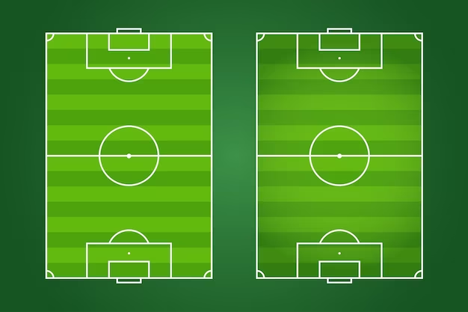
Finding weaknesses (continued)
Arsenal Football Club Wing-wise stats
Goals: 3
Shots: 20 SoT: 6 Crosses: 12
Dribbles: 8 Key Passes: 16
xG: 2.6
Left Wing
Goals: 5
Shots: 27 SoT: 9 Crosses: 20
Dribbles: 12 Key Passes: 21
xG: 4.1
Right Wing
Goals: 5
Shots: 27 SoT: 9 Crosses: 15
Dribbles: 25 Key Passes: 21
xG: 3.8
Left Wing
Goals: 4
Shots: 17 SoT: 7 Crosses: 13
Dribbles: 12 Key Passes: 17
xG: 2.2
Right Wing
Between GameWeek 17 and 24 Arsenal’s Left wing was significantly weaker than its right wing
GW 17-24
GW 24-30

Slide 11
Filling in the gaps
Once the weaknesses in our squad have been identified, we will look at our database for potential replacements.
If the weakness is lack of squad depth, we can find cheap alternatives to our current starting players.
It is possible for a player to play in multiple positions, so if a team has a squad depth weakness in several positions, our algorithm can find a single player to cover in all of those.
If the weakness is a quality based one, we can find a slightly more expensive top quality player who can make an immediate impact playing in that position

Slide 12
Filling in the gaps (CONT)
If you go back 2 slides you will notice a much improved Arsenal left wing after GW 24
This is because of their new signing Leandro Trossard who stated playing on the left wing since GW 24
Arsenal identified their weak left side in terms of depth and quality and signed him as a replacement after looking at his stats
Trossard Stats for his old club: Goals: 7, Shots: 42, SoT: 19, Crosses: 42, Dribbles: 18, Key Passes: 13, xG: 9.9
While Arsenal may have solved their problem by signing a player who has done well in their own league, other teams may not be able to afford such an expensive player.
This is where our project comes in to find similar players from across Europe who fit the profile your club needs.

Slide 13
Other uses of xG in football analytics
Just like we saw how xG can be used to find attacking players for a football club, it can be used to find defenders who concede less goals as well through xGC or expected goals conceded
xG can also be used tactically in preparation for a game.
If your next opponent creates more xG down their left flank then you will have to focus your defensive efforts down that flank.
Similarly if your opponent concedes less xGC down one flank, it will be an advantage to attack them down the other flank.

Slide 14
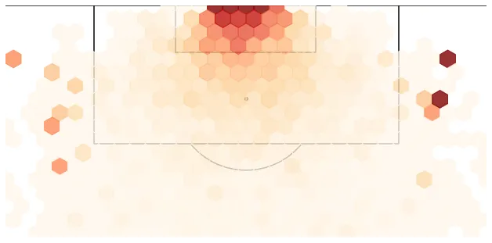
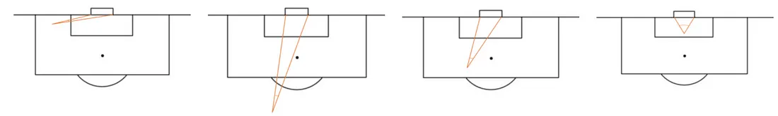
Using xg for tactics
Tactics are a crucial part of any sport, let alone football.
In game tactics could be GAME-CHANGING.
This enhances the prospect of xG further.
A single graph or a heatmap can have many inferences.

Slide 15
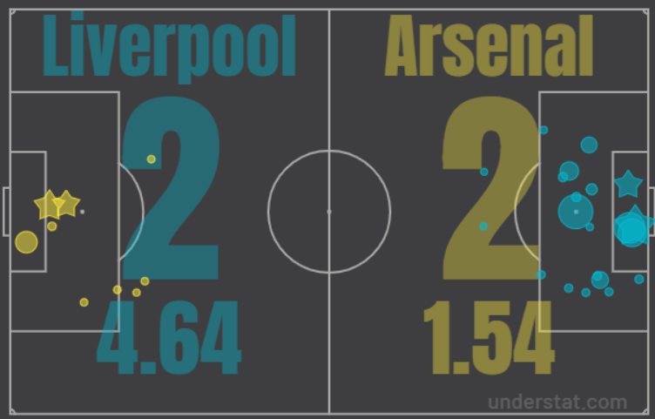
xG for Tactics- Demo
In this graphic we can see in the game between Liverpool and Arsenal Arsenal have conceded many shots down their left flank but no goal.
So their next opponent should see this data and focus their attacks down their left wing.

Slide 16
xG- Ocean of Opportunities
As observed, xG can prove to be a boon to many teams, and is a daily dose to thousands of analysts.
Setting up an xG powered scouting network could be a real game-changer in the field of sports analytics.
This is only a SMALL PART OF WHAT xG CAN DO!!

